Slide 1
R E G I O N X A N D C A R A G A
21st
Annual Regional Convention
___N O N – A C A D E M I C E V E N T S___

Slide 2
Annual Regional Convention
21st
R E G I O N X A N D C A R A G A
N O N – A C A D E M I C E V E N T S
^{3rd} Cine JPIA
X Factor Region 10 and CARAGA – Duo Ed.
Dance Craze 2013
JPIANS Got Talent Season 3
The Amazing Race - Butuan
Mixed Volleyball
Men’s Basketball
RFJPIA’s Next Top Models
Fun games (non-bearing)

Slide 3
Annual Regional Convention
21st
N O N – A C A D E M I C E V E N T S
R E G I O N X A N D C A R A G A
General Guidelines
1. The participants for each non-academic event must be bona fide members of the NFJPIA Federation Year 2012-2013.
2. All participants must be a registered delegate of the 21st Annual Regional Convention.
3. Failure to follow guidelines two (2) and three (3) means disqualification of the participants.
4. The local chapter must confirm to the vice president for non-academic affairs should they join any non-academic event on or before December 20, 2012 either through email or text message.
5. Each local chapter must submit the (File name: 21st ARC Entry Form) attached herein through email on or before December 20, 2012.
6. Failure to comply with guidelines five (5) and six (6) means non-participation in any non-academic event.
7. A local chapter representative must submit on the 1st day of the convention during registration a long brown envelope per non-academic event containing photocopies of school I.D. per participant and other hard copy requirements per event.
8. Every participant is not restricted as to the number of non-academic events that he/she will be joining.

Slide 4
Annual Regional Convention
21st
N O N – A C A D E M I C E V E N T S
R E G I O N X A N D C A R A G A
9. Any changes on the list of participants per event are allowed only until the 1st day of the convention during registration.
10. The order of performance for cultural events shall be determined through drawing of lots during registration.
11. The participants must be at the venue of the contest 30 minutes before the scheduled time.
12. Participants under the influence of liquor and/or narcotics are prohibited from performing.
13. Using of props in all non-academic events is allowed except hazardous elements like fireworks, ladder, any form of vehicle, sharp objects, etc.
14. Costumes must be decent and must be fully supported.
15. All entries submitted to the NFJPIA – Region X and CARAGA Council shall become their property.
16. There shall be a five (5) point deduction per rule violated on the final score.
17. Deduction shall be made by the Chairman of the Board of Tabulators.
18. The local chapter will be informed with their deductions before the awarding of winners.

Slide 5
Annual Regional Convention
21st
N O N – A C A D E M I C E V E N T S
R E G I O N X A N D C A R A G A
19. The decision of the Board of Judges, once announced, is final.
20. Awarding of winners will be announced on the awarding ceremony.
21. Any queries or clarifications with regards to the guidelines for non-academic events must be raised to the vice president for non-academic affairs a week before the convention.
22. Any protests questioning the validity of the guidelines for non-academic events during the event will no longer be entertained.

Slide 6
Annual Regional Convention
21st
N O N – A C A D E M I C E V E N T S
R E G I O N X A N D C A R A G A
3rd Cine JPIA________
The NFJPIA – Region X and CARAGA Short Film Festival

Slide 7
Annual Regional Convention
21st
N O N – A C A D E M I C E V E N T S
R E G I O N X A N D C A R A G A
QUALIFICATIONS AND REGISTRATION
1. This competition is open to all local chapters on NFJPIA – Region X and CARAGA Council Federation Year 2012-2013.
2. Each local chapter who is interested to join must confirm to the vice president for non-academic affairs 30 days before the convention or on December 30, 2012 either through email or text message
CONTEST RULES AND MECHANICS
1. Each local chapter is given the freedom to create their own concept of their short film.
2. The scenes must not be vulgar or obscene.
3. The short film should be at least 15 but not exceed 20 minutes excluding the credits.
4. Credits are limited to a maximum of three (3) minutes only.
5. The actors of each film should be bona fide JPIAns.

Slide 8
Annual Regional Convention
21st
N O N – A C A D E M I C E V E N T S
R E G I O N X A N D C A R A G A
6. Each local chapter is free to contact non-JPIAns to assist them in the technical aspect.
7. The NFJPIA – Region X and CARAGA officers should not be involved in any way in the preparation and making of the short film of their own school.
8. The entire film must be subtitled in English regardless of language/dialect used.
9. The theme song must not be original composition.
10. All entries submitted to the NFJPIA – Region X and CARAGA Council shall become their property.

Slide 9
Annual Regional Convention
21st
N O N – A C A D E M I C E V E N T S
R E G I O N X A N D C A R A G A
REQUIREMENTS AND DEADLINE OF SUBMISSION
SOFT COPIES – to be submitted 2 weeks before the convention or on or before January 18, 2013 through email at vpnonacad.nfjpiaxcaraga@gmail.com.
1. Storyline
(filename: STORYLINE – movie title)
2. Lyrics of the theme song
(filename: LYRICS – movie title)
3. Minus 1/Instrumental music of the theme song
(filename: INSTRUMENTAL – movie title)
4. Sound Track (non-minus 1)
(filename: SOUND TRACK – movie title)
5. Poster (Height: 5ft. x Width: 3ft.)
(filename: POSTER - movie title)
6. One (1) 4R photo of each of the lead actor and actress with a plain white background.
(filename: complete name of the actor/actress – movie title)

Slide 10
Annual Regional Convention
21st
N O N – A C A D E M I C E V E N T S
R E G I O N X A N D C A R A G A
Three (3) copies in a DVD or CD format – must be in the hands of the regional vice president for non-academic affairs 10 days before the convention or on or before January 25, 2013 to be submitted personally or through courier.
Shipping details:
Name: Van Anthony G. Dagapioso
Address: clo Carol Montalban, Door 4 Ammar Apartment, Tibanga, Iligan City
Mobile #: 0906-775-6618
The short film
Trailer that should not exceed one (1) minute
NOTE:
Late submission/lack of requirements on due dates will have a deduction of three (3) points on the average score for BEST SHORT FILM.

Slide 11
Annual Regional Convention
21st
N O N – A C A D E M I C E V E N T S
R E G I O N X A N D C A R A G A
AWARDS AND CRITERIA FOR JUDGING
1. Best Short Film
Cinematography 25%
(camera angles, camera movement,
lighting, framing of shots)
Screenplay 25%
(acting performances)
Storyline 20%
Creativity 20%
Over-all Impression 10%
TOTAL 100%
2. Best Theme Song
Relevance to the film 50% Script 20%
Use of song 30%
TOTAL 100%
3. Top Grosser – this award shall be given to the film that garnered the highest sales during the screening.

Slide 12
Annual Regional Convention
21st
N O N – A C A D E M I C E V E N T S
R E G I O N X A N D C A R A G A
4. Best Actor
5. Best Actress
6. Best Trailer
*Awards number four (4) to six (6) shall be given based on the judges’ deliberation.
7. Best Story –this award is given to the entry who garnered the highest total score in the storyline criteria.
8. Best Poster
Creativity 40%
Visual Impact 30%
Originality 30%
TOTAL 100%

Slide 13
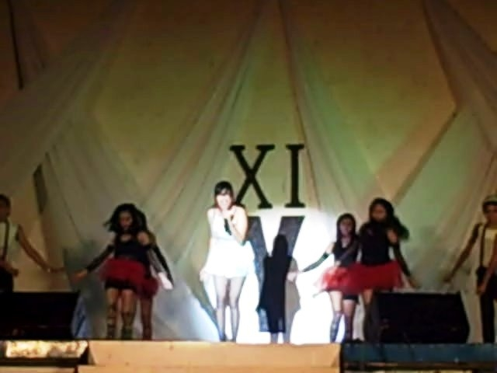
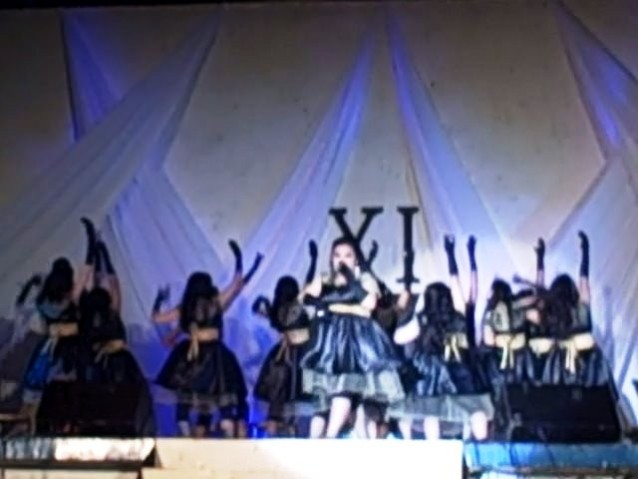
Annual Regional Convention
21st
N O N – A C A D E M I C E V E N T S
R E G I O N X A N D C A R A G A
X Factor Region 10 & Caraga_____
The Regional Search for the Ultimate JPIAN Singing Duo

Slide 14
Annual Regional Convention
21st
N O N – A C A D E M I C E V E N T S
R E G I O N X A N D C A R A G A
1. There shall be two (2) participants for each local chapter. The contestants must be bona fide members of the NFJPIA F.Y. 2012-2013.
2. Participants must be at the venue of the contest thirty (30) minutes before the start of the contest proper and must sign-in upon arrival at the contest proper.
3. The order of performance shall be determined by drawing lots on the 1st day of the convention during registration.
4. Lip synching is not allowed.
5. This competition will be divided into three (3) rounds: the Youtube, the preliminary and the final round.
Youtube round
1. The pair should make a video cover of a song of their own choice (not a music video). They can use any instruments. There could be a maximum of 5 backups. The video should not be more than 5 minutes. Mashed up songs and medleys are strictly prohibited. This must be submitted on or before January 18, 2013.
2. The video be will be posted on Youtube two weeks before the convention.

Slide 15
Annual Regional Convention
21st
N O N – A C A D E M I C E V E N T S
R E G I O N X A N D C A R A G A
The criteria (Video):
Views 50%
Overall impact 50%
Total 100%
Preliminary round
1. This will be scheduled on the 1st night of the convention.
2. The performance is limited to one (1) number only. The choice of song must be of any genre limited to OPM-Tagalog/English or foreign-English songs only. Mashed up songs and medleys are strictly prohibited.
3. The total time covering the entrance, performance and exit is limited to five (5) minutes only. For the 1st 30 seconds exceeding time, there shall be a two (2) point deduction per judge and if the exceeding time will be more than 30 seconds, there shall be a five (5) point deduction per judge.
4. Delay due to technical problems shall not be charged against the five (5) minutes.
5. Using of props is allowed.
6. No back-up dancers are allowed.

Slide 16
Annual Regional Convention
21st
N O N – A C A D E M I C E V E N T S
R E G I O N X A N D C A R A G A
The performance of the contestants in this round will be judged base on the following criteria:
VOICE QUALITY 40%
CREATIVITY AND CHOICE OF PIECE 15%
STAGE PRESENCE 15%
DICTION AND PRONUNCIATION 20%
AUDIENCE IMPACT 10%
TOTAL 100%
Final Round
1. This will be scheduled on the 2nd night of the convention.
2. The performance is limited to one (1) number only. The choice of song must be of any genre limited to OPM-Tagalog/English or foreign-English songs only. Mashed up songs and medleys are strictly prohibited. However, a theme shall be provided by the organizers for the final round. The choice of songs should relate to the given theme which will be announced.
3. The theme is _________.

Slide 17
Annual Regional Convention
21st
N O N – A C A D E M I C E V E N T S
R E G I O N X A N D C A R A G A
4. The total time covering the entrance, performance and exit is limited to five (5) minutes only. For the 1st 30 seconds exceeding time, there shall be a two (2) point deduction per judge and if the exceeding time will be more than 30 seconds, there shall be a five (5) point deduction per judge.
5. Delay due to technical problems shall not be charged against the five (5) minutes.
6. Using of props is allowed.
7. No back-up dancers are allowed.
8. The performance of the contestants in the FINAL round will be judged base on the following criteria:
VOICE QUALITY 40%
RELATION TO THEME 15%
CREATIVITY AND CHOICE OF PIECE 15%
STAGE PRESENCE 15%
DICTION AND PRONUNCIATION 10%
AUDIENCE IMPACT 5%
TOTAL 100%

Slide 18
Annual Regional Convention
21st
N O N – A C A D E M I C E V E N T S
R E G I O N X A N D C A R A G A
The overall basis would be:
Youtube 20 %
Preliminary round 35 %
Final Round 45%
Total 100%
The decision of the Board of Judges is final and irrevocable.
Winners will be announced on the Awards Night

Slide 19
Annual Regional Convention
21st
N O N – A C A D E M I C E V E N T S
R E G I O N X A N D C A R A G A
TAKE NOTE!!!
1. Selected songs for the elimination and final round must be included on the “21st ARC Entry Form” file. In case of similarities of choices of song, 1st come 1st basis shall be observed, thus, validating only the 1st contestant to submit.
2. The following are to be submitted to the vice president for non-academic affairs on or before January 18, 2013.
Two (2) recent 4R photos (close-up and half body) in casual wear with white background.
Minus 1/Instrumental song of chosen piece.
Suggested file name:
Elimination round: ELIMINATION_<name of LC>_<song title>
Final round: FINAL_<name of LC>_<song title>

Slide 20
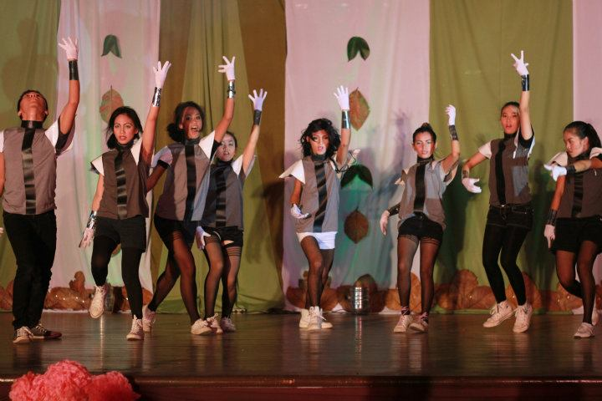
Annual Regional Convention
21st
N O N – A C A D E M I C E V E N T S
R E G I O N X A N D C A R A G A
Dance Craze 2013___________
1. There shall be one (1) GROUP participant for each local chapter. They must be bona fide members of the NFJPIA F.Y. 2012-2013.
2. Participants must be at venue of the contest thirty (30) minutes before the start of the contest and must sign-in upon arrival at the contest venue.
3. The order of performance shall be determined by drawing lots on the 1st day of the convention during registration.
4. Participants are NOT allowed to leave the contest venue unless with proper permission from the authorized facilitator of the contest.
5. Each group should consist of at least eight (8) but not more than twelve (12) members.
6. There should only be one piece for this competition to be provided by the vice president for non-academic affairs and will be disseminated on or before December 30, 2013.
7. The costume and dance movements should not be obscene or vulgar

Slide 21
Annual Regional Convention
21st
N O N – A C A D E M I C E V E N T S
R E G I O N X A N D C A R A G A
8. The presentation should not exceed five minutes including the entrance and exit. For the 1st 30 seconds exceeding time, there shall be a two (2) point deduction per judge and if the exceeding time will be more than 30 seconds, there shall be a five (5) point deduction per judge.
CRITERIA FOR JUDGING
Showmanship 40%
Choreography 25%
Costume 10%
Stage presence 15%
Audience Impact 10%
TOTAL 100%
The decision of the Board of Judges shall be final and not negotiable.
Announcement of winners shall be at the Awards Night of the Convention.

Slide 22
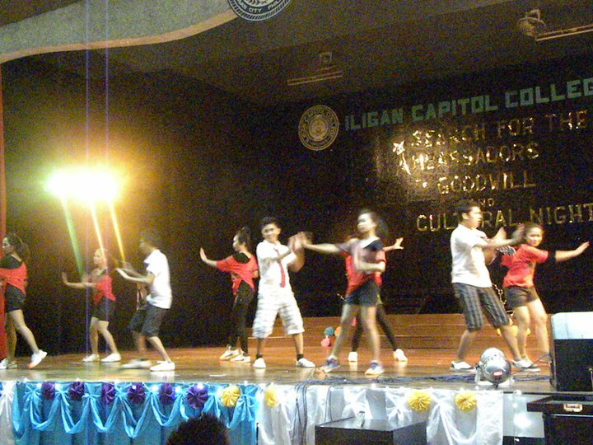
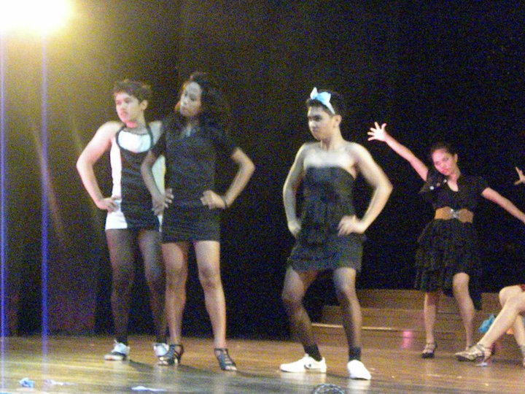
Annual Regional Convention
21st
N O N – A C A D E M I C E V E N T S
R E G I O N X A N D C A R A G A
JPIANS Got Talent Season 3____
The Clash of the LC Heads

Slide 23
Annual Regional Convention
21st
N O N – A C A D E M I C E V E N T S
R E G I O N X A N D C A R A G A
1. Participants must be current Local Chapter officer/s. The Local Chapter must be bona fide member of the NFJPIA F.Y. 2012-2013.
2. Participants can either perform a solo or group performance. A group performance should have a maximum of 15 members.
3. The participants must be at the venue of the contest 30 minutes before the scheduled time.
4. Participants must perform only one (1) piece. Use of props is allowable.
5. Contestants shall be given a 3-5 minutes to perform. For the 1st thirty (30) seconds exceeding time, there shall be a two (2) point deduction per judge and if the exceeding time will be more than thirty (30) seconds, there shall be a five (5) point deduction per judge.
6. Contestants shall be given a 3-5 minutes to perform. For the 1st thirty (30) seconds exceeding time, there shall be a two (2) point deduction per judge and if the exceeding time will be more than thirty (30) seconds, there shall be a five (5) point deduction per judge.
7. There shall be a 5-point deduction per judge per rule violation and shall be made by the Chairman of the Board of Tabulators, duly concurred by the members and in consultation with the board of Judges.

Slide 24
Annual Regional Convention
21st
N O N – A C A D E M I C E V E N T S
R E G I O N X A N D C A R A G A
The individual or group shall be judged based on the following criteria:
Uniqueness of talent 40 %
Choreography
(originality, creativity, style &
interpretation) 30%
Stage Presence 10 %
Costume 10 %
Audience ImPACT 10 %
TOTAL 100 %
The decision of the board of judges is final and non-negotiable.
Announcement of winners shall be at the Awards Night of the Convention.

Slide 25
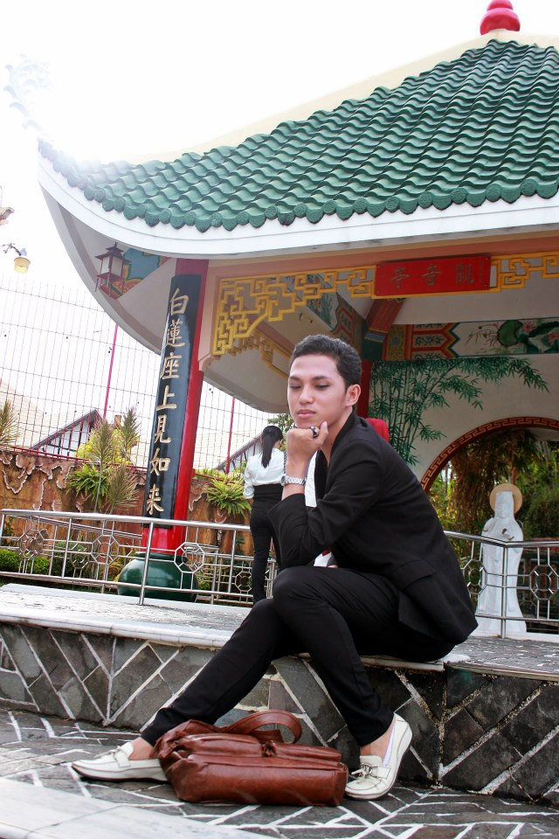
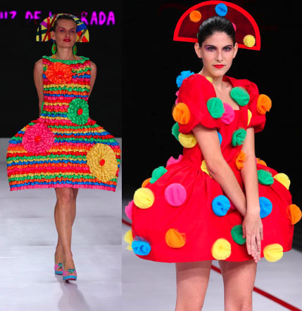
Annual Regional Convention
21st
N O N – A C A D E M I C E V E N T S
R E G I O N X A N D C A R A G A
RFJPIA’s Next Top Models______
The Battle of Beauty and Fashion

Slide 26
Annual Regional Convention
21st
N O N – A C A D E M I C E V E N T S
R E G I O N X A N D C A R A G A
1. There shall be one (1) GROUP participant for each local chapter. They must be bona fide members of the NFJPIA F.Y. 2012-2013.
2. Participants must be at venue of the contest thirty (30) minutes before the start of the contest and must sign-in upon arrival at the contest venue.
3. The order of performance shall be determined by drawing of lots on the 1st day of the convention during registration.
4. Participants are NOT allowed to leave the contest venue unless with proper permission from the authorized facilitator of the contest.
5. There shall be at 5 members per group consisting of three (3) females and two (2) males.
6. The groups must submit their most creative picture together (theme: “environmental issues” ) and from which one will be awarded as the Best Photo. It will judged according to the following criteria:
Creativity 50%
Overall impact 50%
Total 100%

Slide 27
Annual Regional Convention
21st
N O N – A C A D E M I C E V E N T S
R E G I O N X A N D C A R A G A
7. The groups shall have two exposures : 1st night – Vampire-inspired fashion; 2nd night- animal print.
8. Each group is given only a maximum of four (4) minutes for the ramp. There will be a two point (2) deduction for every minute of excess.
9. The groups’ performance on the ramp shall be judged on the following criteria:
Showmanship (grace, poise, creativity & coordination) 25 %
Choreography 25 %
Costume 30 %
Stage Presence 10 %
Overall Appeal 10 %
TOTAL 100 %
Overall basis:
Photo 10%
1st exposure 45%
2nd exposure 45%
Total 100%
The decision of the board of judges is final and irrevocable.

Slide 28
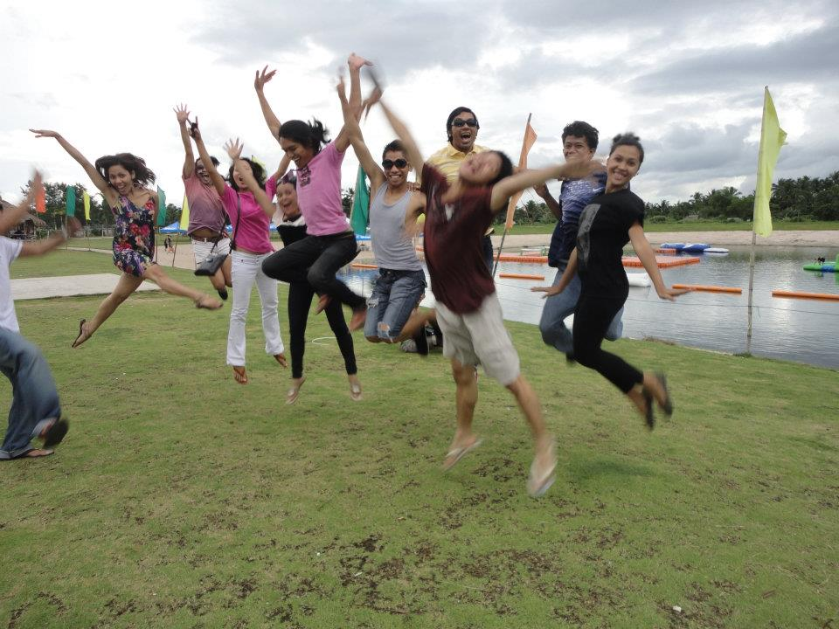
Annual Regional Convention
21st
N O N – A C A D E M I C E V E N T S
R E G I O N X A N D C A R A G A
Amazing Race BUTUAN_____

Slide 29
Annual Regional Convention
21st
N O N – A C A D E M I C E V E N T S
R E G I O N X A N D C A R A G A
The Amazing Race
1. There should only be one (1) team per local chapter composing of three (3) girls and three (3) boys for a total of six (6) members. They must be bona fide members of the NFJPIA F.Y. 2012-2013.
2. Participants must be at the venue of the contest thirty (30) minutes before the start of the contest and must sign-in upon arrival at the contest venue.
3. All members must be in appropriate attire. They must wear their local chapter JPIA shirt. They are not allowed to use any private vehicles.
4. The team must bring the following during the race:
Camera
1 Cellphone (with at least 50 pesos load)
1st aid kit
Notebook
Ballpen/Pencil
Stopwatch
Pocket money (at least Php500)

Slide 30
Annual Regional Convention
21st
N O N – A C A D E M I C E V E N T S
R E G I O N X A N D C A R A G A
5. The organizers will provide waiver to each members of the team.
6. The mechanics of the game will be discussed on the contest proper before the game starts.

Slide 31
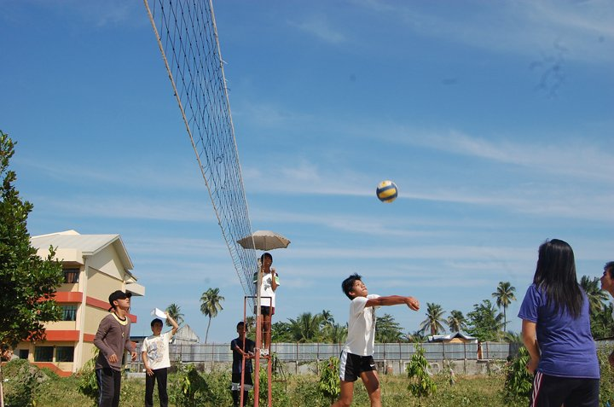
Annual Regional Convention
21st
N O N – A C A D E M I C E V E N T S
R E G I O N X A N D C A R A G A
Mixed Volleyball____

Slide 32
Annual Regional Convention
21st
N O N – A C A D E M I C E V E N T S
R E G I O N X A N D C A R A G A
Mixed Volleyball
1. There should only be one (1) team per local chapter composing of five (5) girls and five (5) boys for a total of 10 members. They must be bona fide members of the NFJPIA F.Y. 2012-2013.
2. The same gaming rules in a regular volleyball game should be followed.
3. During the game, only three (3) boys and three (3) girls are allowed to play.
4. Each player should observe proper sports attire. (jeans, slippers, sandals and leather shoes are not allowed)
5. The schedules for the game shall be announced before the event starts.
6. The manner on which to select the teams who would qualify for the finals would be single eliminations.
7. For the eliminations, each game would only compose of one set which shall consist of 25 points.
8. To determine the winning team for the finals, they should win two (2) out of the three (3) sets of the game. Sets should consist of 25 points.
9. For the 3rd set, it shall be composed of 15 points.
10. The decision of the umpire is final.

Slide 33
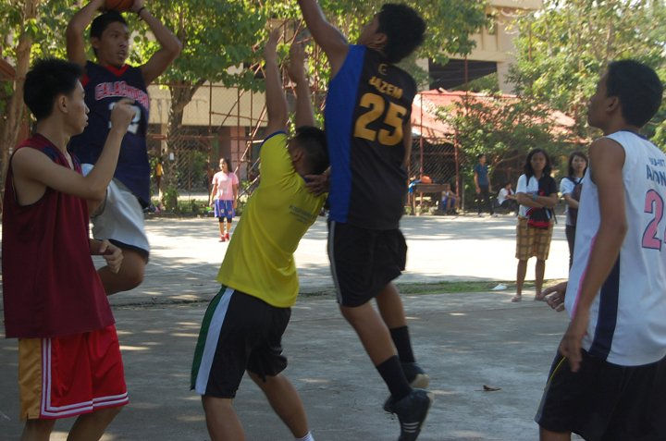
Annual Regional Convention
21st
N O N – A C A D E M I C E V E N T S
R E G I O N X A N D C A R A G A
Men’s Basketball____

Slide 34
Annual Regional Convention
21st
N O N – A C A D E M I C E V E N T S
R E G I O N X A N D C A R A G A
Men’s Basketball
1. There should only be one (1) team per local chapter composing of at least seven (7) and a maximum of 10 members. They must be bona fide members of the NFJPIA F.Y. 2012-2013.
2. Each team must provide a referee. He/she must be a member of the NFJPIA
3. The same gaming rules in a regular volleyball game should be followed.
4. At the start of the game, each team shall consist of five (5) players, one of whom shall be the captain.
5. Each player should observe proper sports attire. (jeans, slippers, sandals and leather shoes are not allowed)
6. The schedules for the game shall be announced before the event starts.
7. The manner on which to select the teams who would qualify for the finals would be single eliminations.
8. For the eliminations, each game would only compose of two (2) quarters which will be good for 15 minutes running time each.
9. Fighting for third and championship games will have four (4) quarters good for 12 minutes each.
10. The decision of the referee is final.

Slide 35
Annual Regional Convention
21st
N O N – A C A D E M I C E V E N T S
R E G I O N X A N D C A R A G A
THANK You so much!

